Slide 1



HexNode
DEVCON 8 · WORKSHOP · 60 MIN
Build one blinky thing. Join a wall of 100.
Notes:
Welcome. In the next hour you will each build one module of a 100-module light wall: solder it, program it, and hang it up. First, a quick detour to explain why a blinky LED has anything to do with a conference run by the Ethereum Foundation.

Slide 2
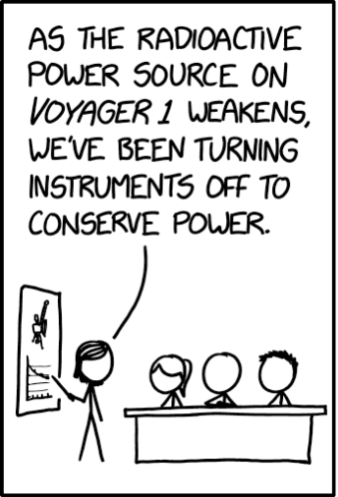
Voyager 1 is running out of power.
PANEL 1 OF 3
The mission team has been switching instruments off, one by one, to stretch what is left.
Xkcd #3302
Voyager Instruments
Randall Munroe
Notes:
Set the scene. Voyager is decades into its mission and the power budget keeps shrinking, so the team has to turn things off. Show panel 1 of xkcd 3302 on the left. (Check the caption against the panel you crop.)

Slide 3
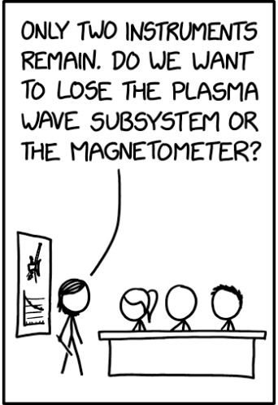
Which one goes next?
PANEL 2 OF 3
Every watt is spoken for, so someone has to pick what to sacrifice. Nobody enjoys this meeting.
Xkcd #3302
Voyager Instruments
Randall Munroe
Notes:
The team has to decide which instrument to give up next. Let the audience guess what Greg will say before you click.

Slide 4
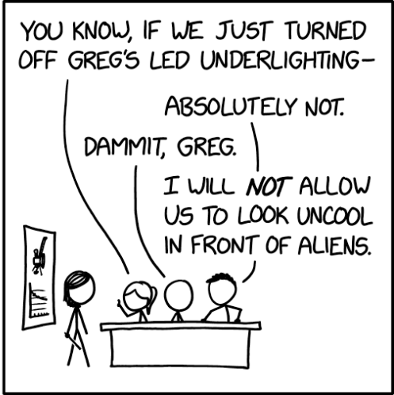
Greg has priorities.
PANEL 3 OF 3
The instruments are negotiable. The lights are not.
Which is why we are building a wall of 100 of them.
Xkcd #3302
Voyager Instruments
Randall Munroe
Notes:
The reveal: for Greg, the LEDs are the one thing that must stay on. That is the answer to what blinky LEDs have to do with Devcon: they are mission critical. Check this caption against the actual panel 3 wording before presenting, and swap in the real reason if it differs.

Slide 5


Almost every system, in four boxes
POWER SUPPLY
batteries not included
INPUT
CONTROL
OUTPUT
Sensors
Brain
Actuators
Notice what is going on.
Decides what to do about it.
Makes something happen.
A thermostat. A toaster. Voyager 1. And, in about an hour, a very large wall of LEDs.
Notes:
Almost everything you will ever build is this diagram: sensors tell a controller what is happening, the controller decides, and actuators act, all fed by a power supply. Say the examples out loud and let the room fill in their own.

Slide 6

One HexNode, in the same four boxes
5V POWER · power bank or bench supply
INPUT
CONTROL
OUTPUT
Touch spring
ESP32
LED ring
Wire on GPIO 4. Feels fingers and hovering hands.
Reads touch, tracks neighbours, times the wave.
16 WS2812B LEDs on GPIO 13.
Other nodes, over the ESP-NOW radio. No router.
Notes:
Same diagram, now with real parts. The touch spring is the sensor, the ESP32 is the brain, the LED ring is the output. The dashed arrow is the extra trick: the ESP32 also talks to its neighbours over its built-in radio. GPIO numbers match the sketch in the repo; update them here if your wiring differs.

Slide 7

Nodes gossip. Waves spread.
1 · Say hello
Every node sends a tiny beacon once a second. No router, no Wi-Fi password, no drama.
2 · Meet the neighbours
Hear a node within two cells? It goes on your list. The grid position you type in makes this exact.
3 · Pass it on
A wave arrives: wait a beat per cell, play it, forward it once. Repeats are ignored, so the gossip dies out.
Touched
+150 ms
+300 ms
Notes:
Each node whispers a hello beacon about once a second, so everyone builds a list of who is nearby. When you touch a node, it sends a wave packet. Neighbours play it after a delay of 150 ms per cell, a little dimmer each hop, and pass it on exactly once. Waving a hand over several modules fires several waves in a row.

Slide 8
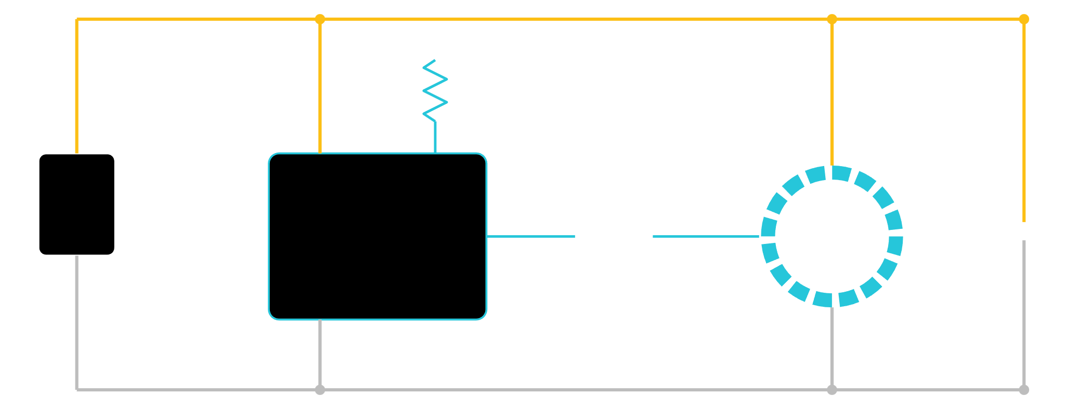
The whole circuit
A resistor, a capacitor and a spring. Your fridge is more complicated.
5V
touch spring
5V
VIN
GPIO 4
5V supply
330 Ω
ESP32
DIN
1000 µF
GPIO 13
16 LEDs
GND
GND
GND
Notes:
Walk the circuit left to right. The external 5V supply goes to VIN and GND. The LED ring takes 5V and ground from the same rails, with a capacitor across them to soak up current spikes. GPIO 13 drives the ring’s data input through a 330 ohm resistor. The touch spring goes straight to GPIO 4. Pin numbers match the sketch in the repo; edit this slide if yours differ. A 470 to 1000 µF capacitor works.

Slide 9
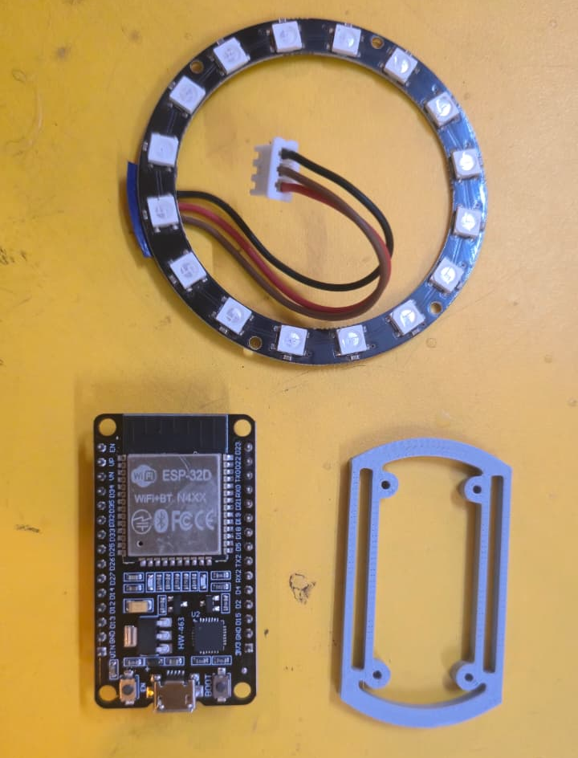
The Parts
STEP 1 OF 5
ESP32 Devkit Module
x16 RGB LED WS2812B (NeoPixel Ring)
3 pin JST connector with wire
  One for the NeoPixel
  One for Power and Touch
Support bracket, 3D printed
Notes:
Add your photo for step 1. Suggested point to make: note which pad is DIN before the ring disappears into the frame.

Slide 10
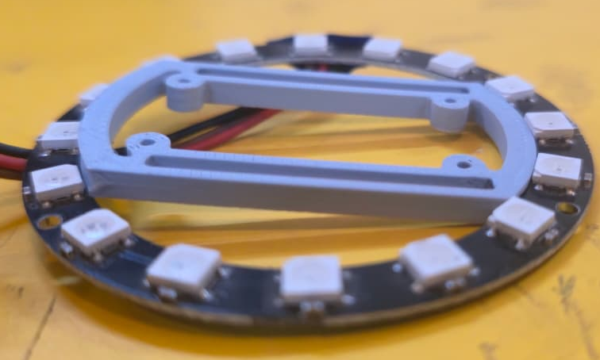
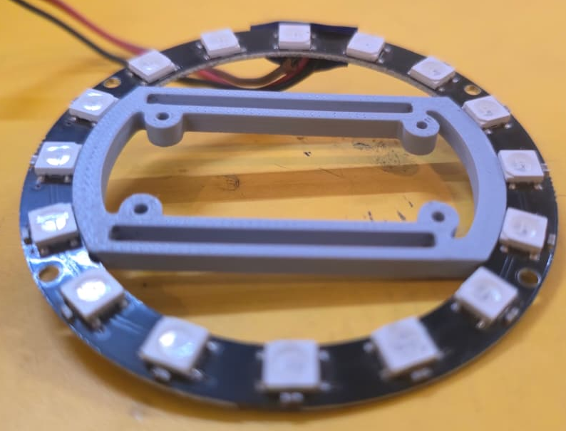
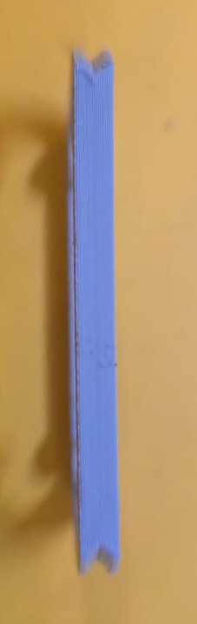
Seat the ring
STEP 1 OF 5
Press the LED ring into the printed frame. Gently: it is a ring, not a walnut.
Notes:
Add your photo for step 1. Suggested point to make: note which pad is DIN before the ring disappears into the frame.

Slide 11
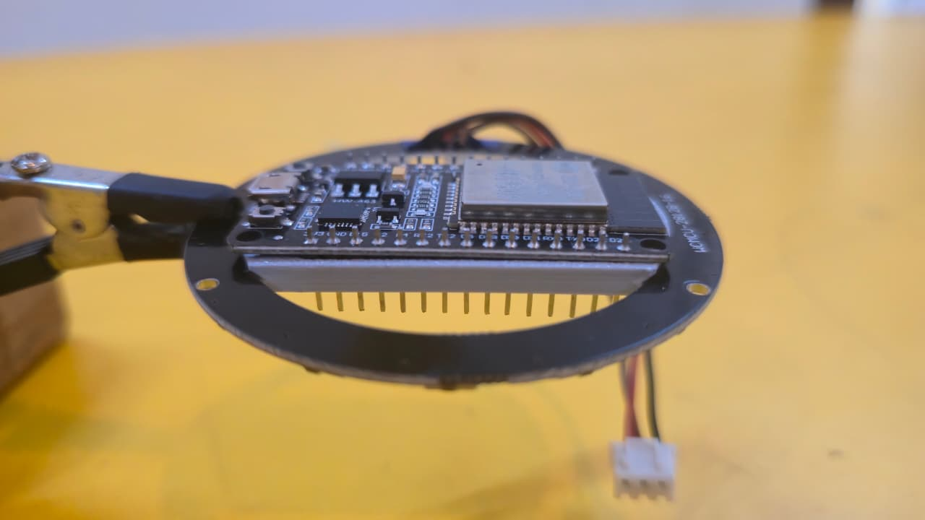
Mount the ESP32
STEP 2 OF 5
Fit the board into the frame. Keep the USB port reachable, because you will flash it in a few minutes.
Notes:
Add your photo for step 2.

Slide 12
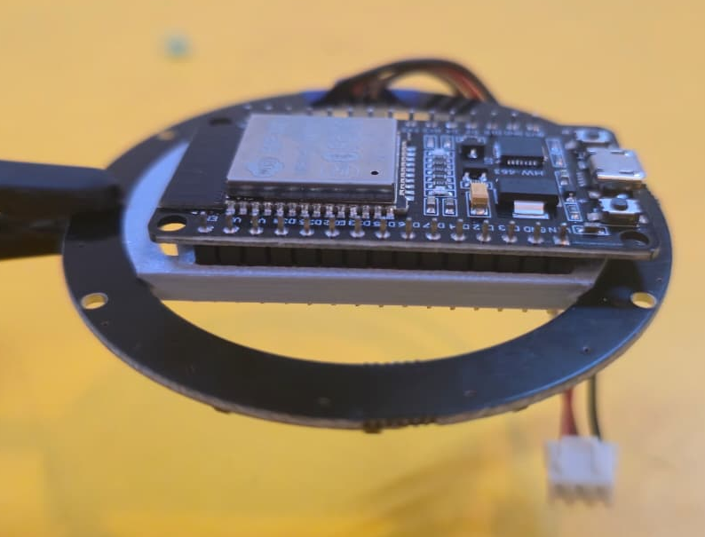
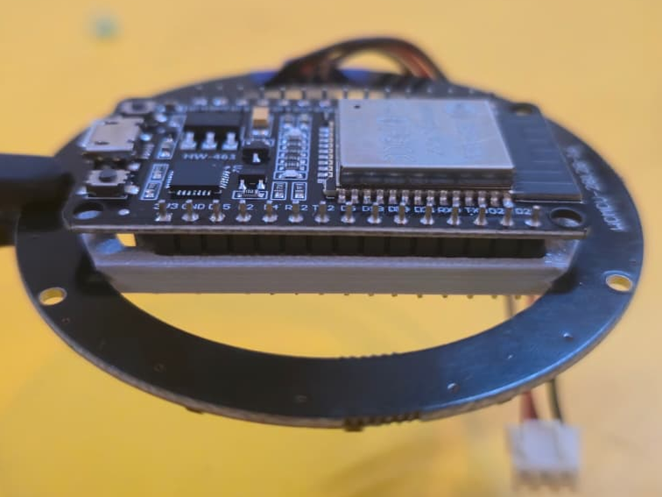
Orient the ESP32
STEP 2 OF 5
The ESP32 has offset pins – make sure you orient it in the right direction
Notes:
Add your photo for step 2.

Slide 13
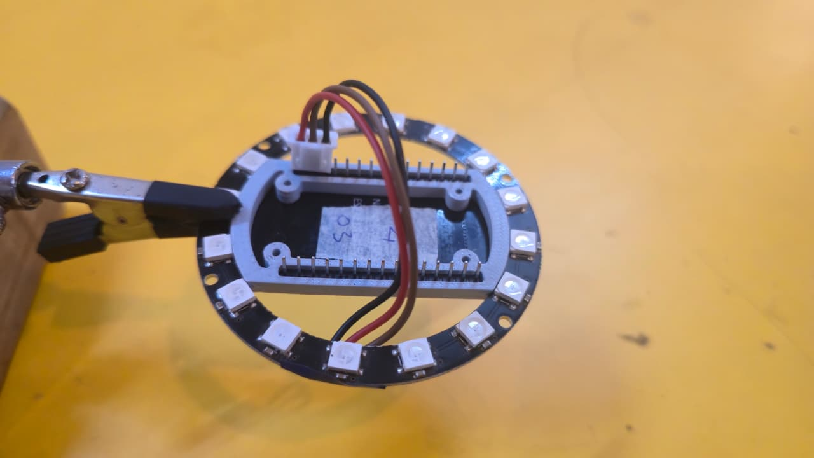
Wire it up
STEP 3 OF 5
5V to VIN, GND to GND, GPIO 13 through the 330 Ω resistor to DIN, spring to GPIO 4. Capacitor across the power pads.
Check the polarity twice. Magic Smoke is not an animation.
Notes:
This is the step where most mistakes happen. Have the circuit slide on the screen or on a handout. Pin numbers match the sketch; update them if your wiring differs. Add your photo for step 3.

Slide 14
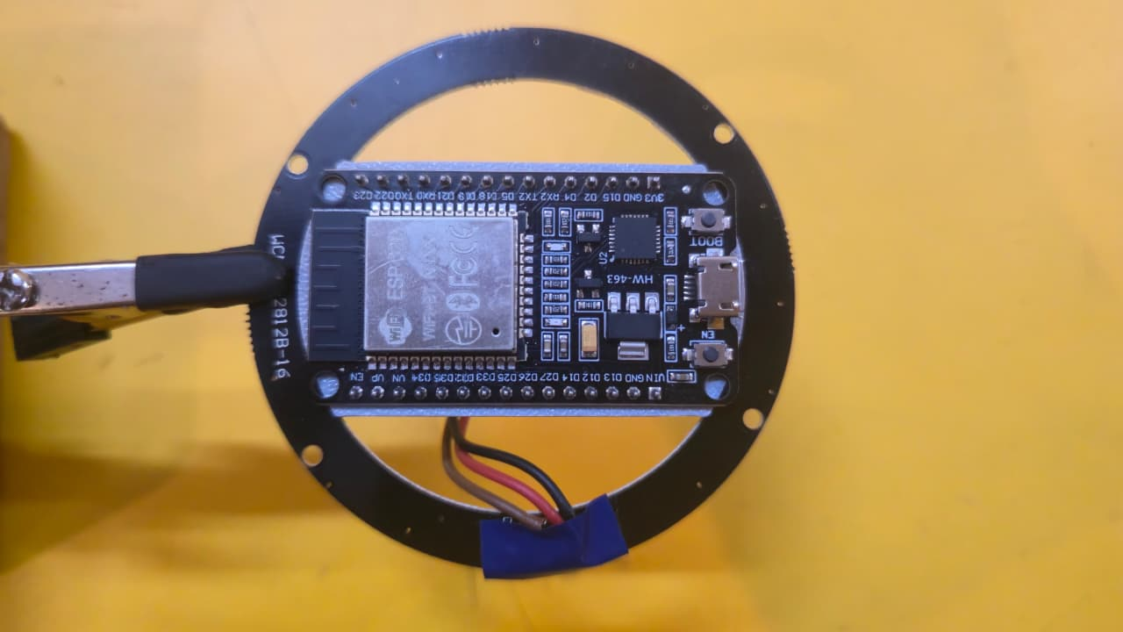
Wire it up
STEP 3 OF 5
5V to VIN, GND to GND, GPIO 13 through the 330 Ω resistor to DIN, spring to GPIO 4. Capacitor across the power pads.
Check the polarity twice. Smoke is not an animation.
Notes:
This is the step where most mistakes happen. Have the circuit slide on the screen or on a handout. Pin numbers match the sketch; update them if your wiring differs. Add your photo for step 3.

Slide 15
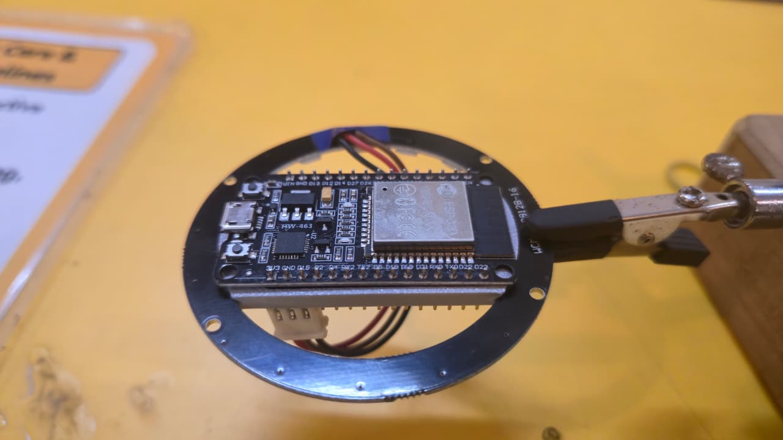
Flash it and number it
STEP 4 OF 5
Upload HexNode.ino, then type your grid position in the Serial Monitor. Every node needs an address on the wall.
Notes:
Each person gets a grid position from you, for example pos 2 1, typed into the Serial Monitor at 115200. It is saved to flash. Use the test command to fire a wave from one node. Add your photo for step 4.

Slide 16
Hang it on the wall
STEP 5 OF 5
Connect power, touch the spring, and wait for your neighbours to light up. Then wave at the whole wall.
Notes:
The payoff. Have people touch their module and watch the ripple travel. Add your photo for step 5.

Slide 17
Get the code
github.com/MakersAsylumIndia/DevCon8_RGB_Wall
1 · Install
2 · Flash
3 · Number it
Arduino IDE, the esp32 board package by Espressif (3.x) and the Adafruit NeoPixel library.
Open HexNode.ino, pick your ESP32 board and port, then upload.
Serial Monitor at 115200, then type your position, for example pos 2 1
Notes:
Point people to the repo. Everything is there: the sketch, the wiring and these slides’ diagrams if you add them. Consider putting the link on a QR code on the final slide so people can scan it from their seats.

Slide 18

Thanks !
show us some
💖 @makersasylum
Website
Insta
X / Twitter
Arduino IDE, the esp32 board package by Espressif (3.x) and the Adafruit NeoPixel library.
Open HexNode.ino, pick your ESP32 board and port, then upload.
Serial Monitor at 115200, then type your position, for example pos 2 1
Notes:
Point people to the repo. Everything is there: the sketch, the wiring and these slides’ diagrams if you add them. Consider putting the link on a QR code on the final slide so people can scan it from their seats.

Slide 19
Photos
1. Parts – ESP32, LED Ring, 3D printed bracket, 2 nos JST connector with wires
2. JST wire #1 – as-is > cut to approx 2 inches, > strip insulation > solder to LED ring
3. JST wire #2 – as-is
4. Connected to USB-C cable (close up of HexNode only)
5. HexNode lighted up

